Slide 1

Hospital BED MANAGEMET SYSTEM

Slide 2
Agenda
Why Hospital Bed Management?
Proposed System
UML Diagrams
Proposed Database View

Slide 3
Why Hospital Bed Management?
It saves time for workers and management by counting and recording the number of beds available.
This application aid in reduce the amount of time patients must wait during an emergency.
The most challenging task to the hospital staff is the make bed available promptly after the surgery.
The hospital bed management system can cope with this difficult situation and smooth the operation of allocating beds to the patients.

Slide 4
Proposed system
In order to plan for the effective use of beds, the hospital bed management system keeps track of all the available beds and the beds that are currently occupied. By cutting down on the time needed to count and record the number of beds available, it benefits the staff and management.
To effectively monitor and manage patient flow through the hospital, the software gives you real-time status information on bed occupancy. The technology smoothly interacts with other solutions to reduce the possibility of double data entry.

Slide 5
Uml Diagrams

Slide 6
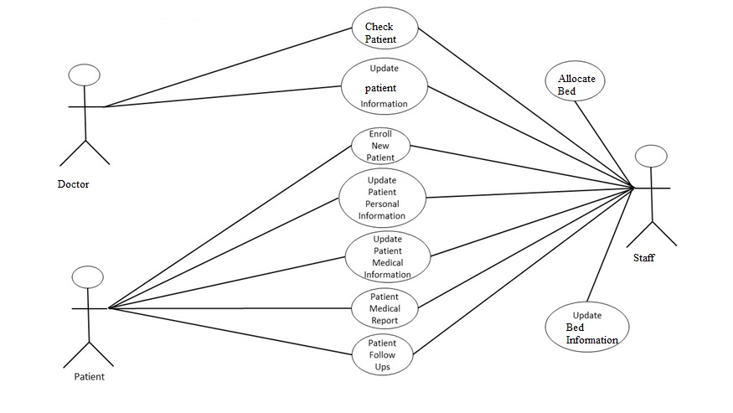
USE CASE

Slide 7
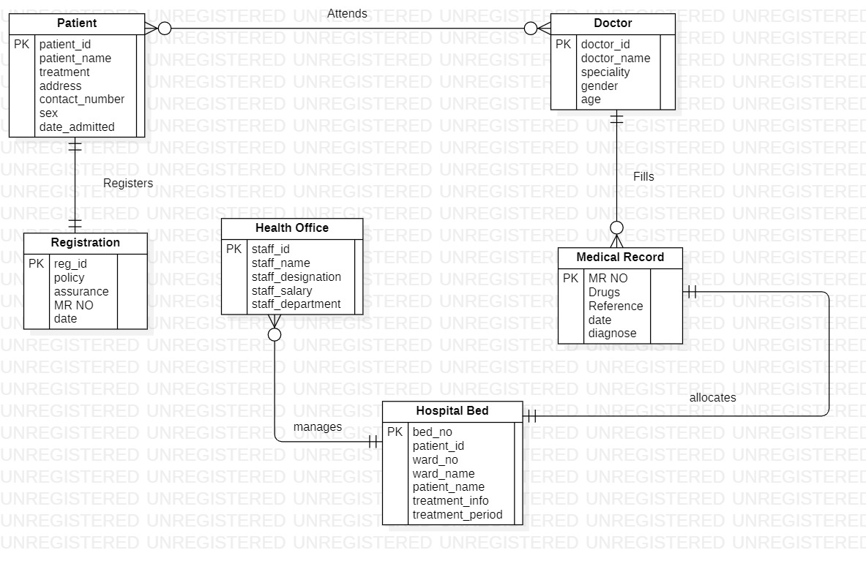
ER Diagram

Slide 8
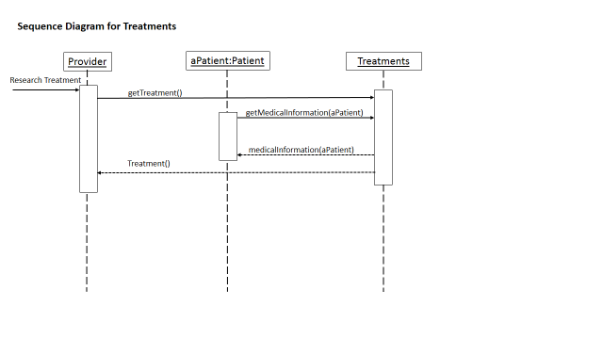
Sequence diagram

Slide 9
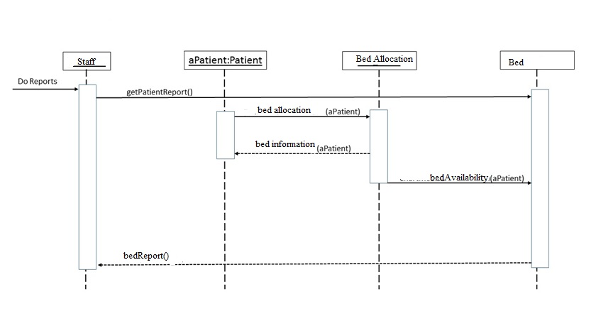
Sequence diagram

Slide 10
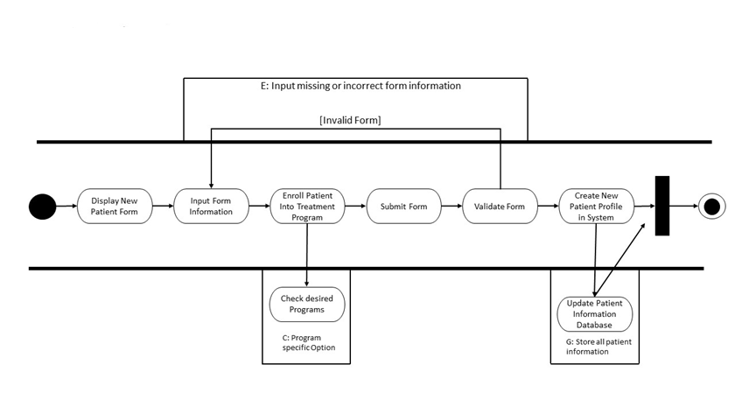
ACTIVITY diagram

Slide 11
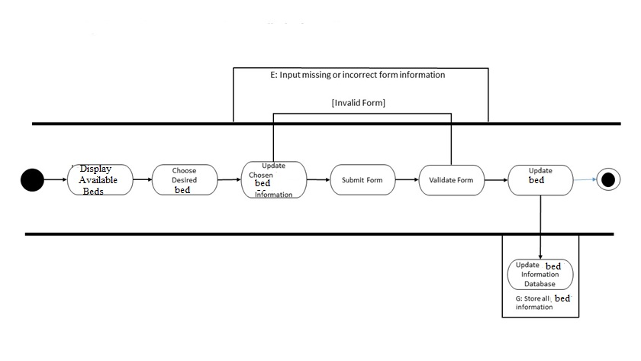
ACTIVITY diagram

Slide 12
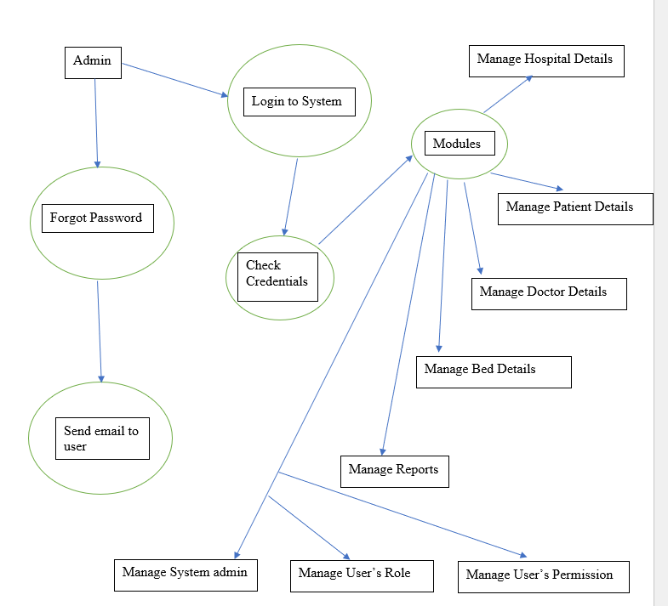
DFD

Slide 13
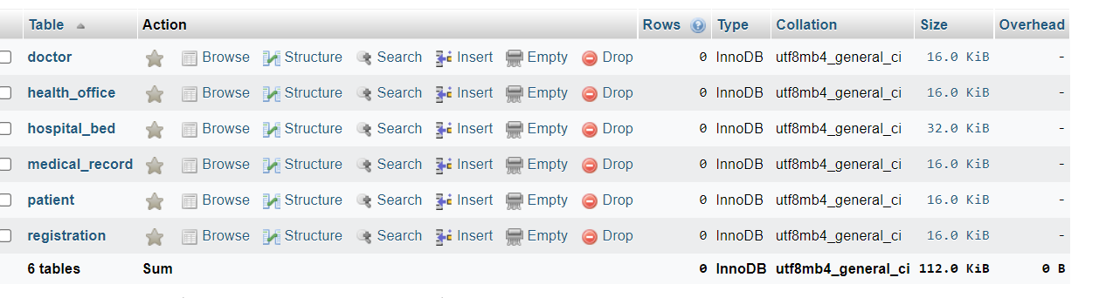
Proposed Database view

Slide 14
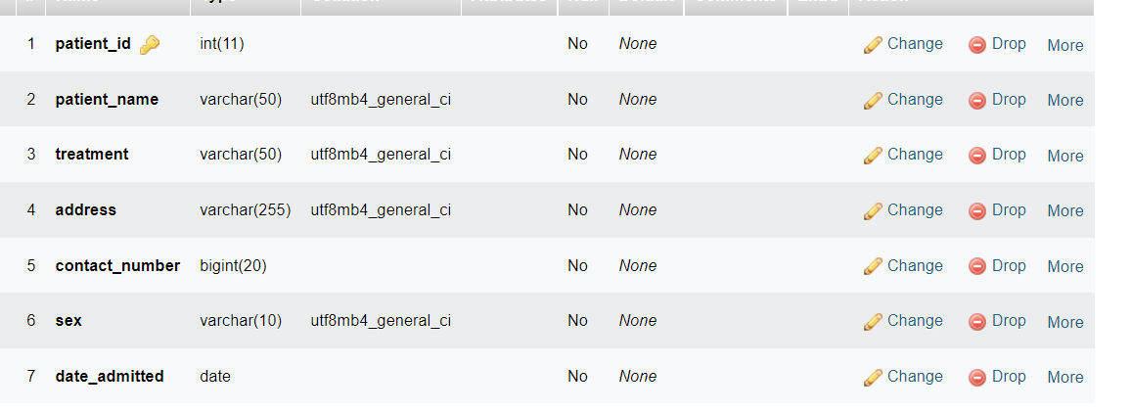
Patient

Slide 15
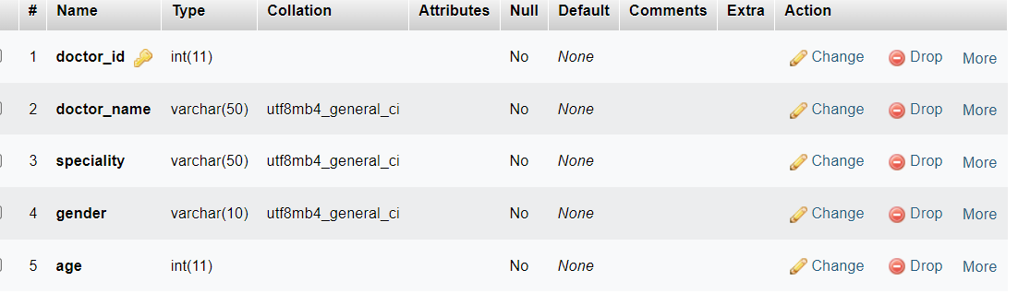
DOCTOR

Slide 16
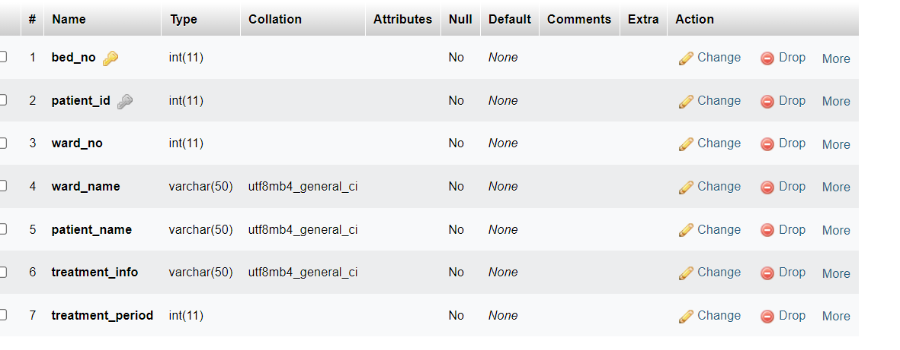
Hospital_Bed

Slide 17
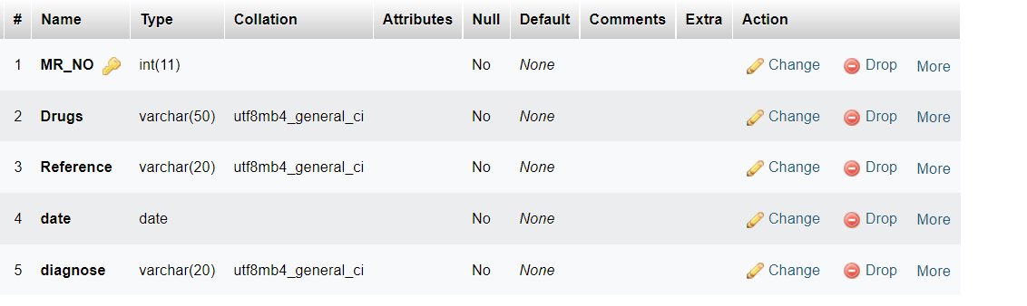
Medical_record

Slide 18
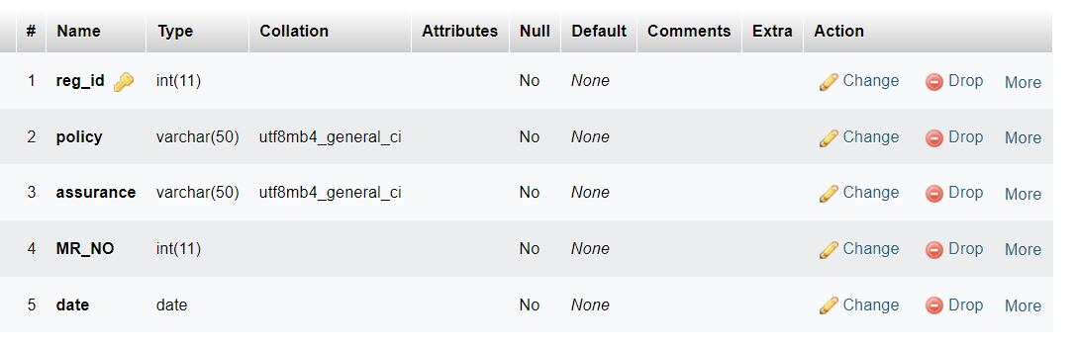
Registration

Slide 19
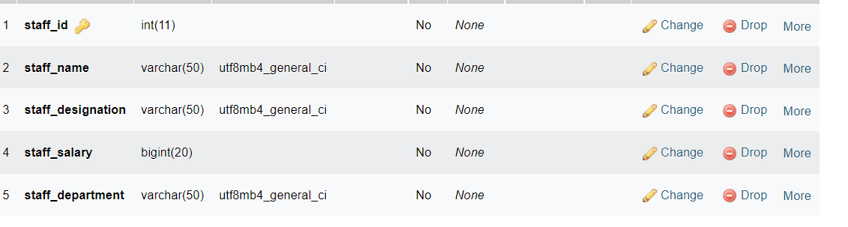
Health_office

Slide 20
Summary
Bed management refers to the capacity of a healthcare facility or system to be operationally aware of the state of all of its available beds in real-time and to be able to plan for the quick utilization of beds through coordination of the bed turnover process. Because beds are a limited resource, access restrictions cause delays and inefficiency in the healthcare industry.
Front end will be using CSS,HTML and JAVA SCRIPT and for backend we will be using JAVA and DATABASE

Slide 21
Thank you
NANDAN VARMA YADLA
ID : 1139150

